Slide 1
5G-And-Beyond Prototyping
Sdmay22-30
Josh Guyer, Josh Naber, Raffael Neuser, Johnathan Leisinger, Connor Kesterson, Ruofeng Gao, Nicholas Garrelts
Client/Advisor: Hongwei Zhang

Slide 2
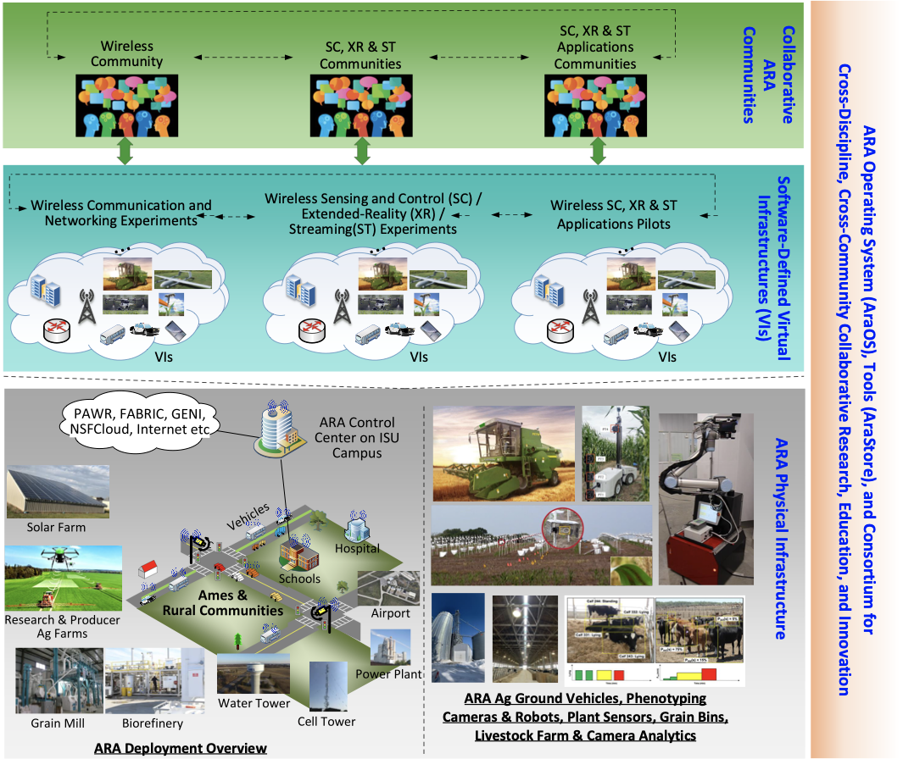
Project Vision
We are creating 5G infrastructure in rural Iowa for research in wireless networks, cloud computing, and remote operation of ag vehicles
ARA- Agriculture and Rural communities
at-scale, deeply-programmable infrastructure for rural wireless research
https://arawireless.org/
Everyone from farmers to schools to rural communities will be affected by our project.
Notes:
Josh G

Slide 3
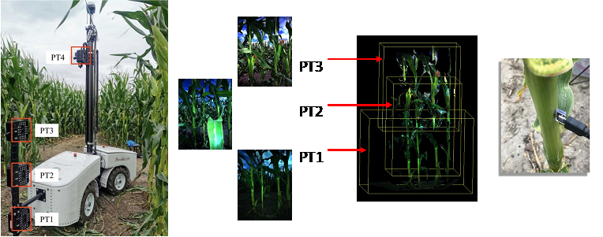
Project Vision
Agricultural uses for 5G infrastructure
remote monitoring for plant phenotyping
automatic video feed of individual animal behavior
connected and automated ag vehicles
AR/VR supervisory control of vehicles
Rural use cases
education
transportation
public safety
tele-health
Notes:
Josh G

Slide 4
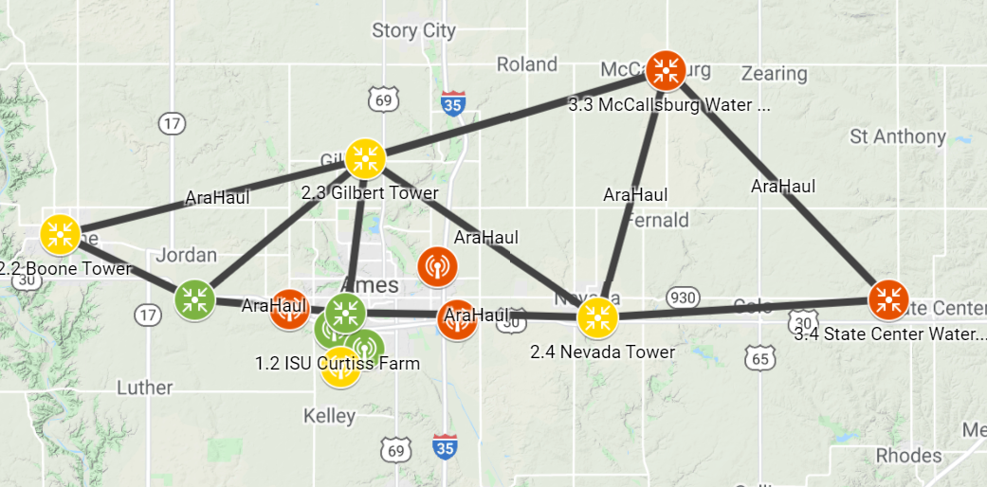
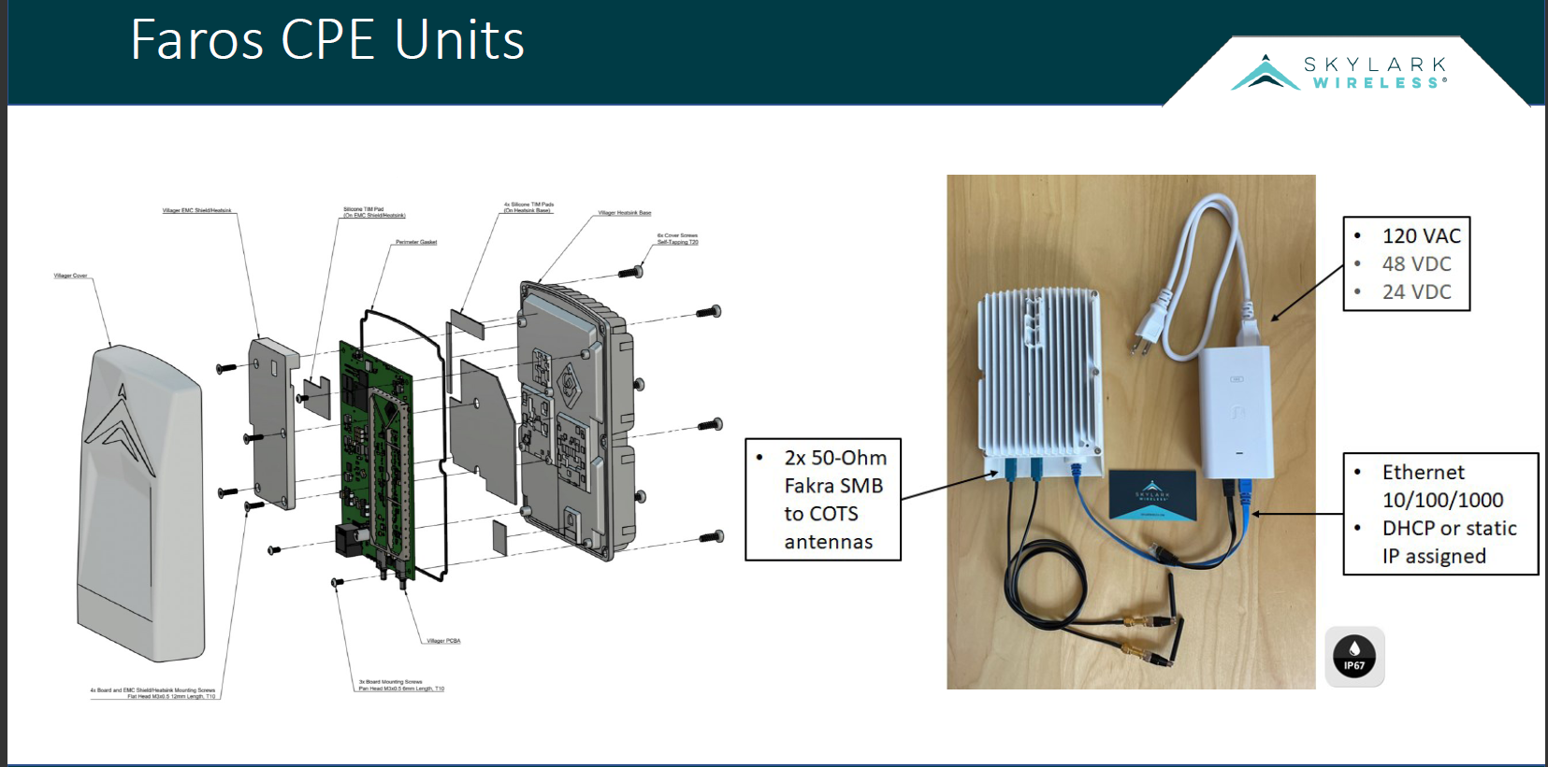
Conceptual/Visual Sketch
This shows the map of the area where ARA will be deployed
Deployed in 3 phases (Green, Yellow, Orange)
Will cover 6 rural cities and one ag farm
Components used
LN Amplifier
Skylark low-UHF mMIMO SDR
X410, B210 SDR
Intel NUC
Notes:
Josh G

Slide 5
Requirements
Design an enclosure to hold all UE radios and components
Able to be mass produced
Heat resistant
Test and verify UE connectivity to base station
Become familiar with interfacing with software testbench
Notes:
John

Slide 6
Requirements
Deploy UEs around Ames
Perform measurements of reliability and speeds
Should be at least at the level of commercial 4G systems
Experiment with different software configurations on UEs
Find best configuration for each UE
Notes:
John

Slide 7
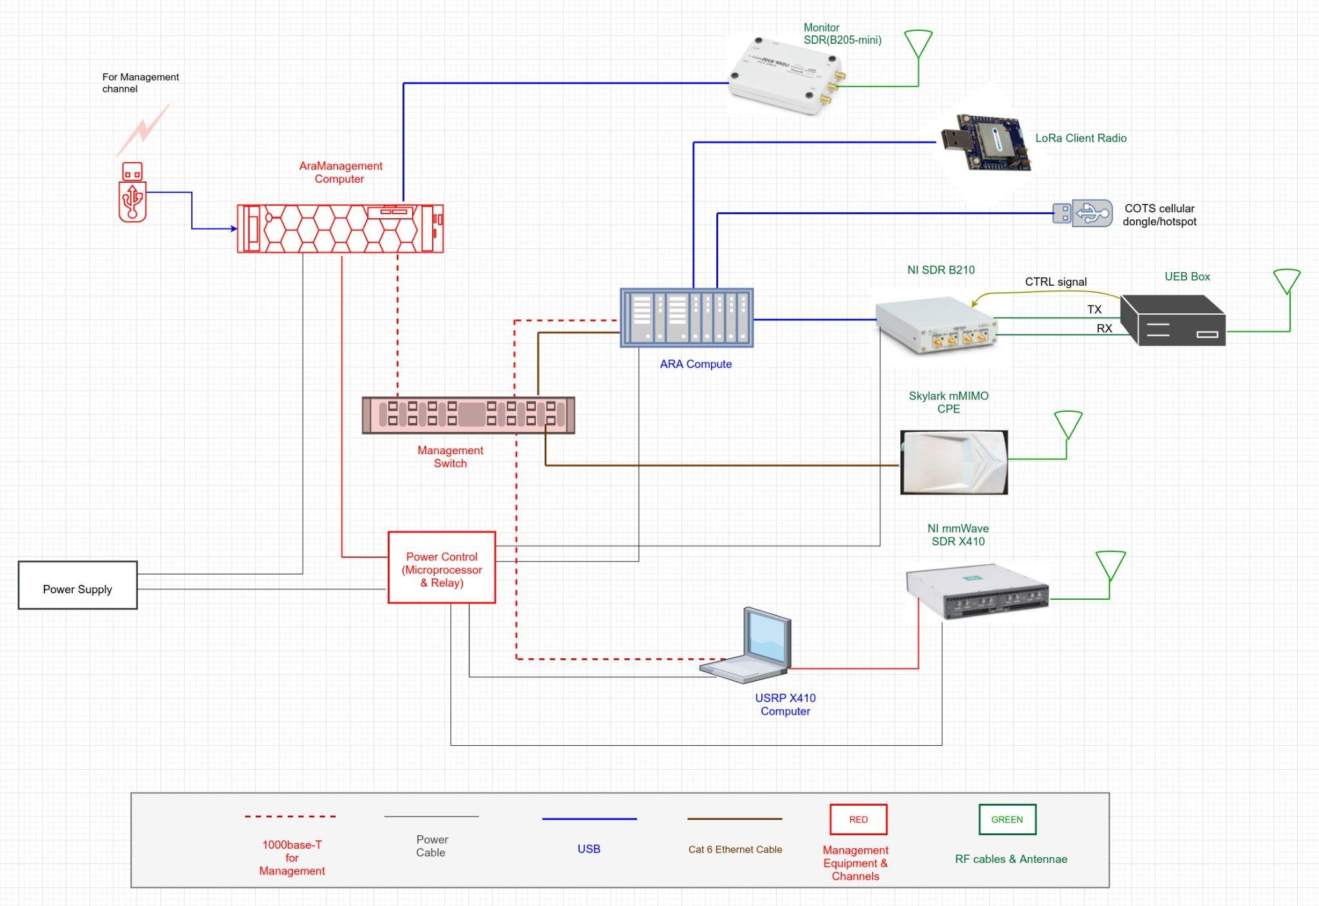
Conceptual Design Diagram
we will make it modular
software and hardware
srsRAN algorithms
intel NUC, b210 SDR, and amplifier, a transformer, skylark MIMO, x410 SDR, and a power supply
Notes:
Ruofeng

Slide 8
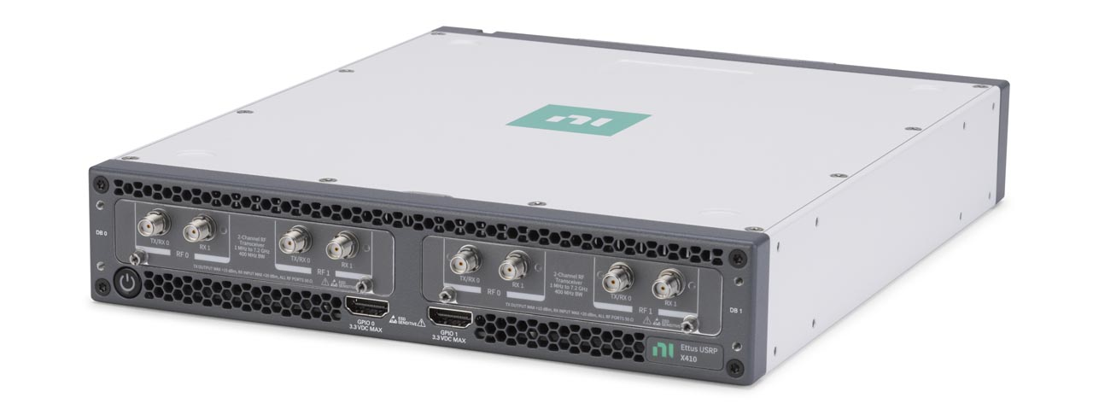
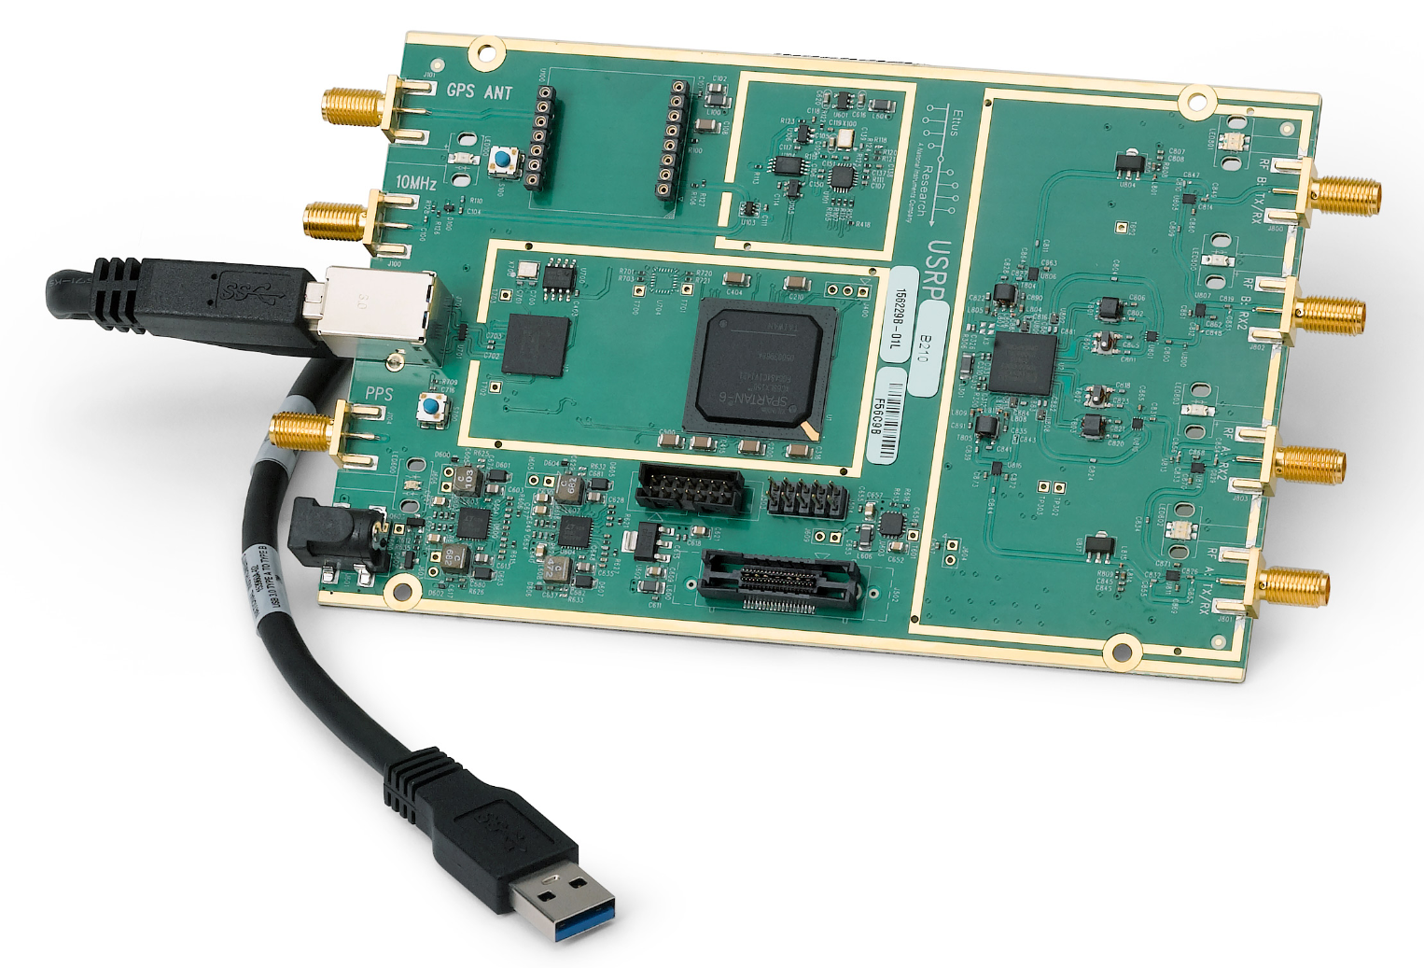
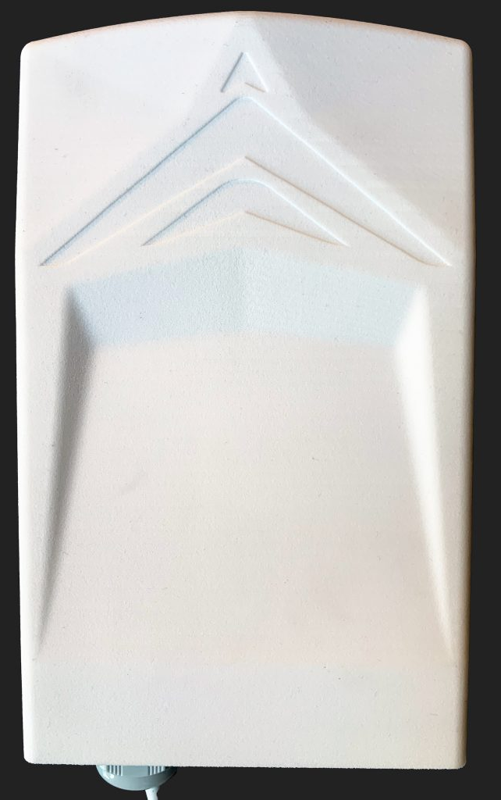
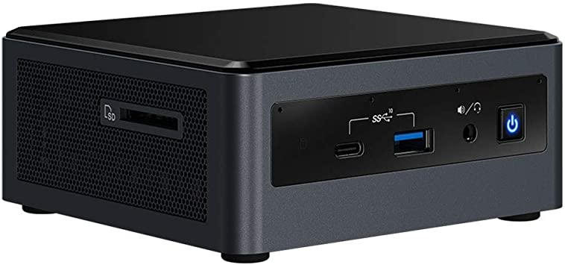
System Design - Hardware
1 MHz – 7.2 GHz, with 400 MHz real-time bandwidth
Real-time bandwidth indicates how much of the frequency spectrum the SDR can continuously sample
USRP X410
USRP B210
70 MHz – 6 GHz, with up to 56 MHz real-time bandwidth
470 – 806 MHz, with 40+ MHz real-time bandwidth
mMIMO
Skylark Faros
Intel Core i7 Processor 16GB RAM Small form-factor computer
Intel NUC
Notes:
Raffael Neuser

Slide 9
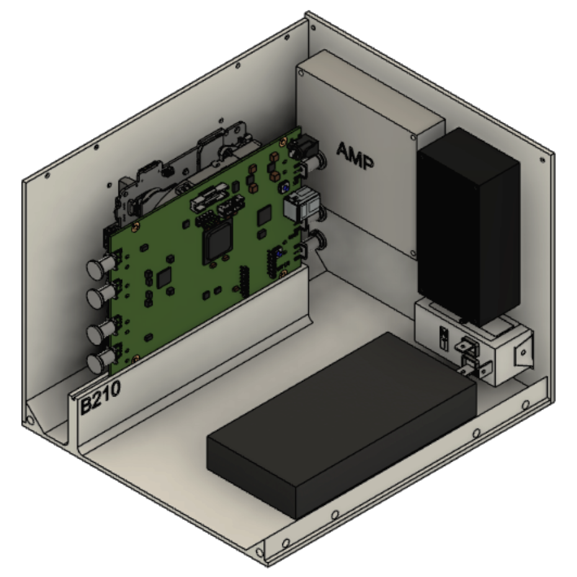
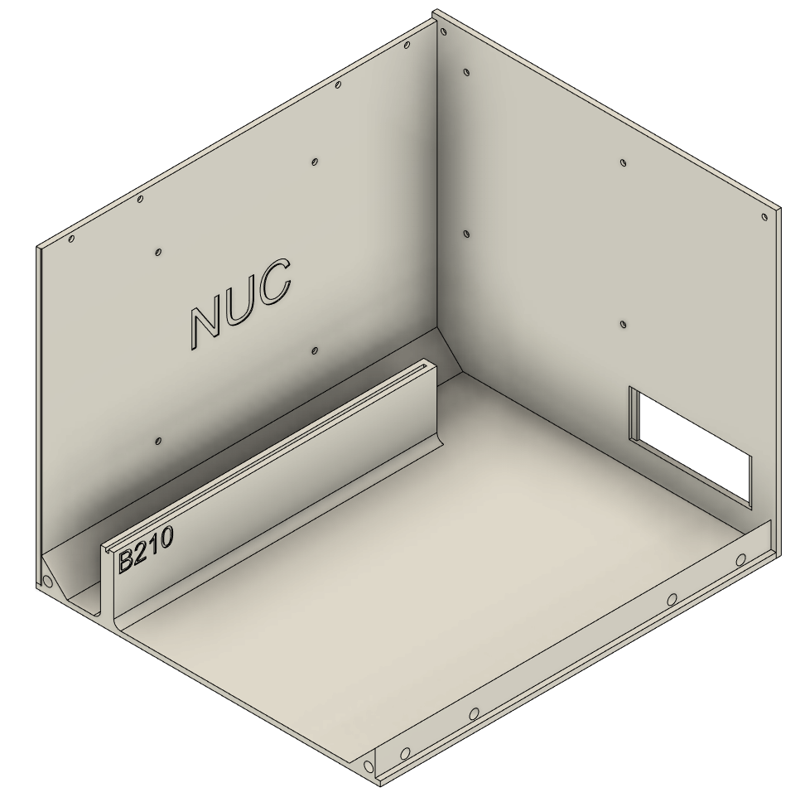
System Design - Enclosure
Enclosures for User Equipment
Hardware
Intel NUC
Software Defined Radios
USRP B210
USRP X410
Skylark mMIMO
Low-noise amplifier to which the SDRs connect
Power supply
Software
5G ‘New Radio’ is the underlying radio access technology
srsRAN
Open source 5G software suite
Uses the SDRs as the front-end for transmitting and receiving
5G research will involve modifying its source code to test different algorithms (i.e. congestion control) to improve metrics (such as bandwidth, latency)
Notes:
Raffael Neuser

Slide 10
Prototype Implementations
Hardware prototype
3D printed model in progress
Software prototype
Load srsRAN code and conduct modifications onto existing testbed to ensure correct functionality
Overall system prototype
srsRAN code modifications implemented on the enclosure’s hardware
Notes:
Nick

Slide 11
Design Complexity
What made your design hard?
Efficiently using space
Getting measurements for components we didn’t have physically
Printer constraints. Only able to 3D print a max size
What kind of design iterations were needed?
Fixing constraints of the hardware design
Slot measurements
3D printing iterations due to errors in printing
Notes:
Josh N

Slide 12
Project Plan
Tasks
Design a enclosure for UE components
Manufacture prototypes of the enclosure and iterate
Apply software to UE and test connection in lab setting to base station
Deploy UE enclosure in Ames and test base station connection
Experiment with 5G-And-Beyond solutions
Implement an algorithm to improve reliability and/or connectivity
Conduct performance measurements
Risks and mitigation plan
Most risks come from hardware side of UE
3D printing errors
Mishandling of hardware
Notes:
Josh N

Slide 13
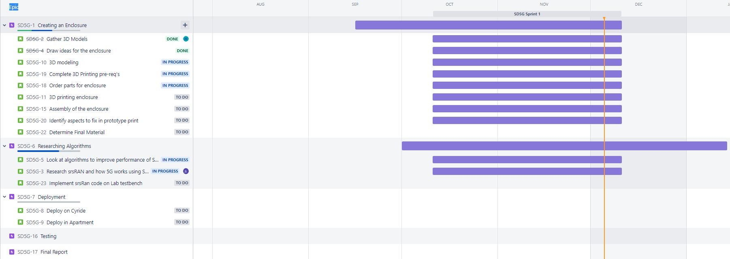
Project Plan – Schedule/Milestones
Teams Jira with Gantt chart
Notes:
Josh N

Slide 14
Test Plan
Testing Enclosure
Making sure components fit
Components work as expected when hooked up properly
Testing Software
Computer and UE are used to test srsRAN code to measure bandwidth
Algorithms run successfully on the SDRs with improved latency
Interface/Integration Testing
Ensuring all items in the enclosure are powered by the power supply and fit inside
Modified software actually making a difference in latency
System Level Testing/Acceptance Testing
Once enclosure and software are completed, making sure they work together
Final enclosure is sturdy and can hold all UE
Final enclosure needs to be mass producible
Software enclosed in the UE enclosure can successfully communicate with base station reliably
Notes:
Connor

Slide 15
Conclusions
Currently 3D printing the enclosure
We have been having some difficulties
Software team is setting up a testbench in Durham
Next semester we will
continue 3D printing the enclosure and design another model
look into easier manufacturing methods
implement software algorithms on the SDRs
test the entire systems and measure performance
deploy systems throughout Ames and surrounding areas
Contributions
Josh G- Helped design 3D model of enclosure and began print it
Josh N- Helped design 3D model by gathering models and helped with 3D printing
Raffael N - Set up local srsRAN test environment, set up the Jira
Connor K- Researching srsRAN algorithms as well as helping set up the srsRAN test bed
John L - Researching srsRAN algorithms and communicating with research assistant for software guidance
Ruofeng G-Researching srsRAN code and understanding the function and method using
Nick G- Researching srsRAN code to best design how we’ll implement modifications and helping get testbed up
Notes:
Josh G

